Slide 1
Corrosion – when it can occur?
18CYB101J
Chemistry
Corrosion in aqueous solutions can occur if and only if the following four fundamental parameters are simultaneously present:
Anode
Cathode
2 electrodes
Ionic circuit
Electrical circuit
2 circuits
The elimination of any one of these necessary four fundamental parameters absolutely prevents corrosion!

Slide 2
Electrode Reactions
18CYB101J
Chemistry
Only one basic metal anodic/oxidation/ “corrosion” reaction:
M → M^{n+} + ne⁻
Several possible cathodic reduction reactions in aqueous environments:
Hydrogen gas generation: 2H⁺ + 2e⁻ → H₂
Water decomposition: 2H₂O + 2e⁻ → H₂ + 2(OH)⁻
Hydroxyl formation: O₂ + 2H₂O + 4e⁻ → 4(OH)⁻
Water formation: O₂ + 4H⁺ + 4e⁻ → 2H₂O
Electroplating: M^{n+} + ne⁻ → M

Slide 3
Corrosion Thermodynamics
18CYB101J
Chemistry
Corrosion is thermodynamically driven to lower the overall energy of the system
Involves electron/charge transfer
Controls the spontaneous direction for corrosion
Thermodynamics provides an understanding of the energy changes involved in corrosion
Thermodynamics can indicate corrosion is possible, i.e., ΔG<0, but thermodynamics cannot predict the rate
Thermodynamics show how conditions may be adjusted to prevent corrosion, i.e., ΔG>0
Change in E or the electron activity or availability at a metal surface has a profound effect on corrosion rate

Slide 4
18CYB101J
Chemistry
Pourbaix diagram
Usage of thermodynamic theory or in other words the Nernst equation to create potential (E) – pH diagram
This is typically comparable to the composition – temperature diagrams (phase diagrams) which is generally for alloy systems
Both diagrams are guide maps
Pourbaix Diagrams plot electrochemical stability for different redox states of an element as a function of pH.
Pourbaix diagram can be read much like a standard phase diagram with a different set of axes. Similarly to phase diagrams, they do not allow for reaction rate or kinetic effects.

Slide 5
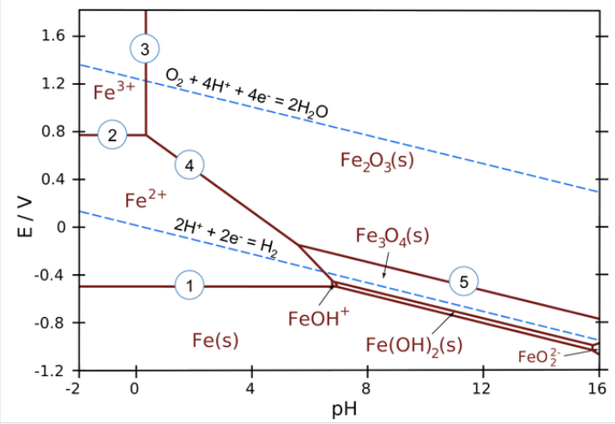
18CYB101J
Chemistry
Pourbaix diagram
Pourbaix diagrams are plotted in the axes Electrode potential of the metal vs. pH of the electrolyte
Oxidizing conditions are described by the top part of the diagram (high positive electrode potential)
Reducing conditions are described by the bottom part of the diagram (high negative electrode potential)
Acidic solutions are presented in the left side of the diagram (pH lower than 7)
Alkaline solutions are presented in the right side of the diagram (pH higher than 7)

Slide 6
Pure redox reactions are horizontal lines - these reactions are not pH-
dependent
Pure acid-base reactions are vertical lines - these do not depend on potential
Reactions that are both acid-base and redox have a slope of -0.0592 V
Examples of equilibria in the iron Pourbaix diagram (numbered on the plot)
Fe²⁺+2e− ⟶ Fe(s) (pure redox reaction - no pH dependence)
2. Fe³⁺+e− ⟶ Fe²⁺ (pure redox reaction - no pH dependence)
3. 2Fe³⁺+3H₂O ⟶ Fe₂O₃(s)+6H+ (pure acid-base, no redox)
4. 2Fe²⁺+3H₂O ⟶ Fe₂O₃(s)+6H⁺+2e⁻ (slope = -59.2 x 6/2 = -178 mV/pH)
5. 2Fe₃O₄(s)+H₂O ⟶ 3Fe₂O₃ + 2H⁺+2e⁻ (slope = -59.2 x 2/2 = -59.2 mV/pH)

Slide 7
For active metals such as Fe, the region where the pure element is stable is typically below the H₂ line. This means that iron metal is unstable in contact with water, undergoing reactions
Fe (s) + 2 H⁺ Fe²⁺ + H₂ (in acid)
Fe (s) + 2 H₂O Fe(OH)₂ + H₂ (in base)
Iron (and most other metals) are also thermodynamically unstable in air-saturated water
4Fe (s) + 3 O₂ + 12 H⁺ 4 Fe³⁺ + 6H₂O
4 Fe + 3 O₂ 2Fe₂O₃

Slide 8
18CYB101J
Chemistry
Pourbaix diagram
Pourbaix diagrams are used to determine the corrosion behavior of a metal in water solutions
In other words, the direction of electro-chemical processes and the equilibrium state of the metal at a certain electrode potential in a water solution at a certain value of pH
Normally, the Pourbaix diagrams are built for the water solutions with the concentrations of metal ions 10⁻⁶M and at the temperature 298K (77ºF/25ºC).

Slide 9
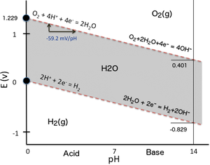
18CYB101J
Chemistry
Pourbaix diagram
As noted above, these diagrams are essentially phase diagrams that plot the map the conditions of potential and pH (most typically in aqueous solutions) where different redox species are stable.
The lines in Pourbaix diagrams represent redox and acid-base reactions, and are the parts of the diagram where two species can exist in equilibrium.
Fig. Pourbaix diagram of water

Slide 10
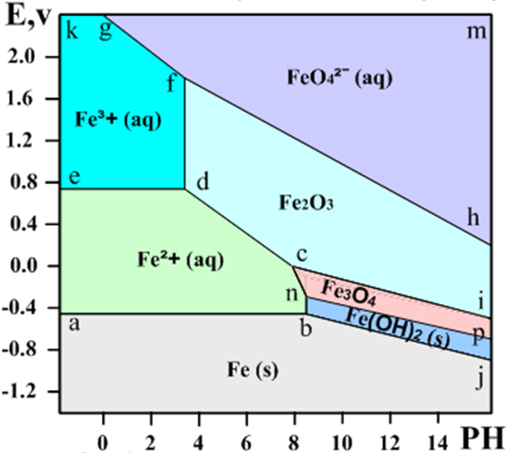
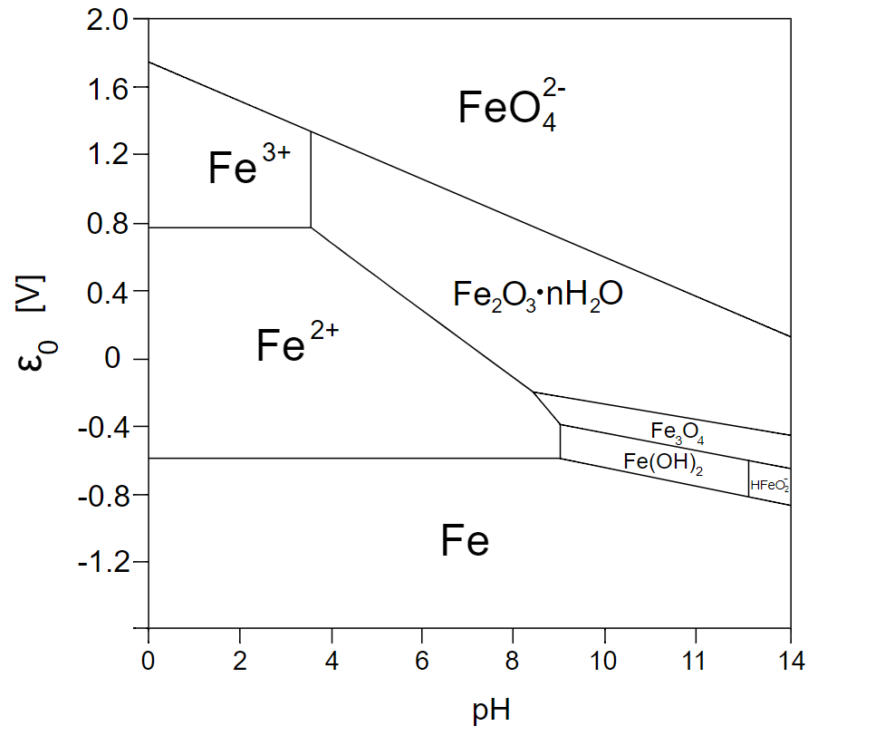
18CYB101J
Chemistry
Pourbaix diagram for Iron(Fe)

Slide 11
18CYB101J
Chemistry
Pourbaix diagram, Fe system
Areas in the Pourbaix diagram mark regions where a single species (Fe²⁺(aq), Fe₃O₄(s), etc.) is stable. More stable species tend to occupy larger areas.
Lines mark places where two species exist in equilibrium.
Pure redox reactions are horizontal lines - these reactions are not pH-dependent
Pure acid-base reactions are vertical lines - these do not depend on potential
Reactions that are both acid-base and redox have a slope of -0.0592 V/pH x #H⁺⁄#e⁻

Slide 12
Pourbaix diagram, Fe system
18CYB101J
Chemistry
The diagram defines the following zones of the equilibrium states:
below the line a-b-j: Solid iron (immunity zone). The electrochemical reactions in this zone proceed in the direction of reduction of iron ions. No corrosion occurs in this zone.
a-b-n-c-d-e: Aqueous solution of ion Fe²⁺(corrosion zone). Metallic iron oxidizes in this zone.
e-d-f-g-k: Aqueous solution of ion Fe³⁺ (corrosion zone). Metallic iron oxidizes (corrodes) in this zone.

Slide 13
Pourbaix diagram, Fe system
18CYB101J
Chemistry
h-f-g-m: Aqueous solution of ion FeO₄²⁻(corrosion zone).
c-d-f-h-i: Solid ferrous oxide Fe₂O₃ (passivation zone). Iron oxidizes (corrodes) in this zone however the resulted oxide film depresses the oxidation process causing passivation (corrosion protection of the metal due to formation of a film of a solid product of the oxidation reaction
n-c-i-p: Solid oxide Fe₃O₄ (Fe₂O₃*FeO) (passivation zone). The oxide film causes passivation.
b-n-p-j: Solid hydroxide (II) Fe(OH)₂ / FeO*nH2O / green rust (passivation zone).

Slide 14
Pourbaix diagram
18CYB101J
Chemistry
Horizontal lines of the Pourbaix diagrams correspond to the redox reactions which are independent of pH
Vertical lines of the Pourbaix diagrams correspond to the non-redox reactions (electrons are not involved), which are dependent on pH
Diagonal lines of the Pourbaix diagrams correspond to the redox reactions, which are dependent on PH.

Slide 15

18CYB101J
Chemistry
Pourbaix diagram for Iron(Fe)
Examples of equilibria in the iron Pourbaix diagram (numbered on the plot):
Fe²⁺ + 2e− → Fe(s) (pure redox reaction - no pH dependence)
Fe³⁺ + e− → Fe²⁺ (pure redox reaction - no pH dependence)
3. 2Fe³⁺ + 3H₂O → Fe₂O₃(s) + 6H⁺ (pure acid-base, no redox)

Slide 16
18CYB101J
Chemistry
4. 2Fe²⁺ + 3H₂O → Fe₂O₃(s) + 6H⁺ + 2e− (slope = -59.2 x 6/2 = -178 mV/pH)
5. 2Fe₃O₄(s) + H₂O → 3Fe₂O₃(s) + 2H⁺ + 2e− (slope = -59.2 x 2/2 = -59.2 mV/pH)
Liquid water is stable only in the region between the dotted lines. Below the H₂ line, water is unstable relative to hydrogen gas, and above the O₂ line, water is unstable with respect to oxygen.
For active metals such as Fe, the region where the pure element is stable is typically below the H₂ line. This means that iron metal is unstable in contact with water, undergoing reactions:
Fe(s) + 2H⁺ → Fe²⁺(aq) + H₂ (in acid) ………………………….. (4.5.1)
Fe(s) + 2H₂O → Fe(OH)₂(s) + H₂ (in base) ...…………………... (4.5.2)
Iron (and most other metals) are also thermodynamically unstable in air-saturated water, where the potential of the solution is close to the O₂ line in the Pourbaix diagram. Here the spontaneous reactions are:
4Fe(s) + 3O₂ + 12H + → 4Fe³⁺ + 6H₂O (in acid) …………………. (4.5.3)
4Fe(s) + 3O₂ → 2Fe₂O₃(s) (in base) …………………………....…. (4.5.4)

Slide 17
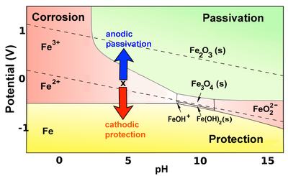
Corrosion and Passivation
The corrosion of iron (and other active metals such as Al) is indeed rapid in parts of the Pourbaix diagram where the element is oxidized to a soluble, ionic product such as Fe³⁺(aq) or Al³⁺(aq). However, solids such as Fe₂O₃, and especially Al₂O₃, form a protective coating on the metal that greatly impedes the corrosion reaction. This phenomenon is called passivation.
Draw a vertical line through the iron Pourbaix diagram at the pH of tap
water (about 6) and you will discover something interesting: at slightly
acidic pH, iron is quite unstable with respect to corrosion by the reaction:
Fe(s) + 2H⁺ → Fe²⁺(aq) + H₂ (4.5.5)
but only in water that contains relatively little oxygen, i.e., in solutions
where the potential is near the H₂ line. Saturating the water with air
or oxygen moves the system closer to the O₂ line, where the most stable
species is Fe₂O₃ and the corrosion reaction is:
4Fe(s) + 3O₂ → 2Fe₂O₃ (s) (4.5.6)
This oxidation reaction is orders of magnitude slower because the oxide that is formed passivates the surface.
Therefore iron corrodes much more slowly in oxygenated solutions.
More generally, iron (and other active metals) are passivated whenever they oxidize to produce a solid product, and corrode whenever the product is ionic and soluble.
In the yellow part of the diagram, an active metal such as iron can be protected by a second mechanism, which is to bias it so that its potential is below the oxidation potential of the metal.

Slide 18
Pourbaix diagram limitations
18CYB101J
Chemistry
M-H₂O diagrams present equilibria among metal, metal ions and solid oxides in systems where only metal, water, H⁺ and OH⁻ exist. This is not the real world scenario. Missing out on many things…..
The diagrams consider pure metals and aqueous solutions at standard conditions ONLY (temperature 298K, pressure 1 bar, ion concentration 10⁻⁶M).
Diagram is based on pure metals, not alloys
These equilibrium thermodynamic diagrams reveal nothing concerning corrosion kinetics

